Slide 1

SWENG 837 Final Project
Sowmya Talasila

Slide 2

Project
Dynamin Ride Sharing App
Uses optimized routes and increases prices according to the demand
Target Audience:
Customers
Drivers
Administrators

Slide 3
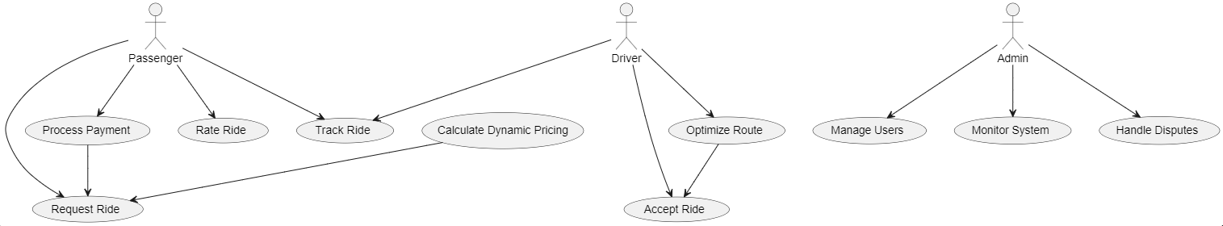
UML Use case diagram

Slide 4
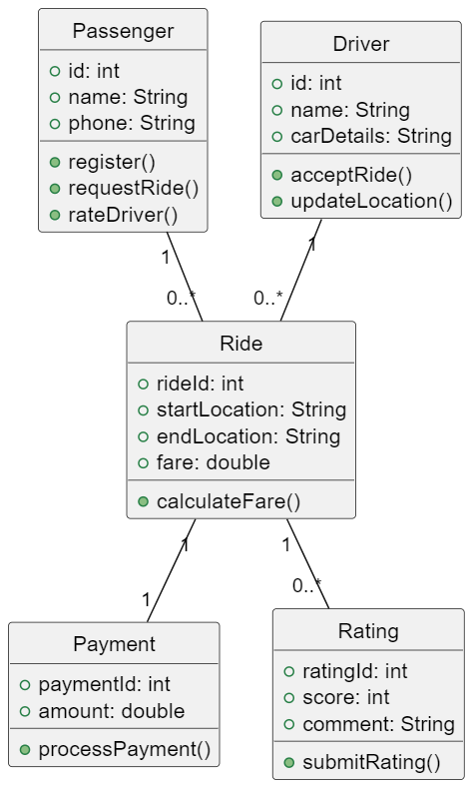
UML DOMAIN MODEL Diagram

Slide 5
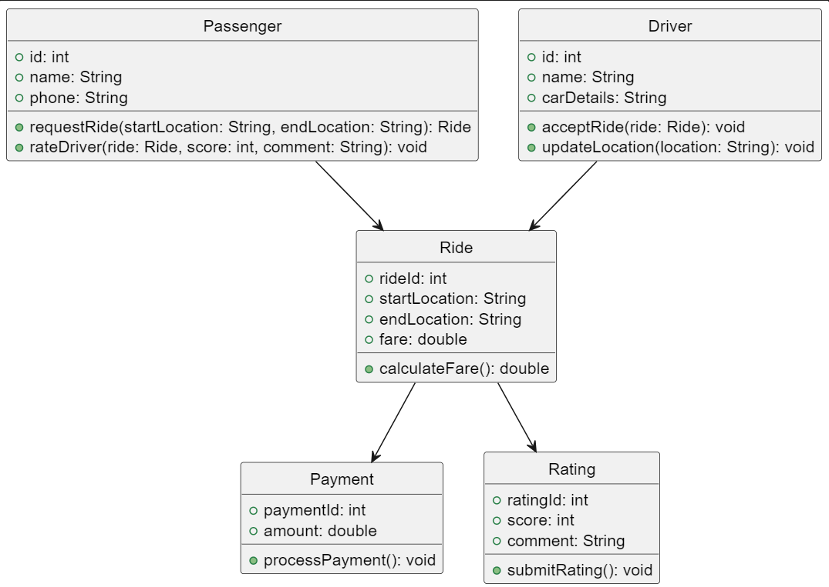
UML CLASS DIAGRAM

Slide 6
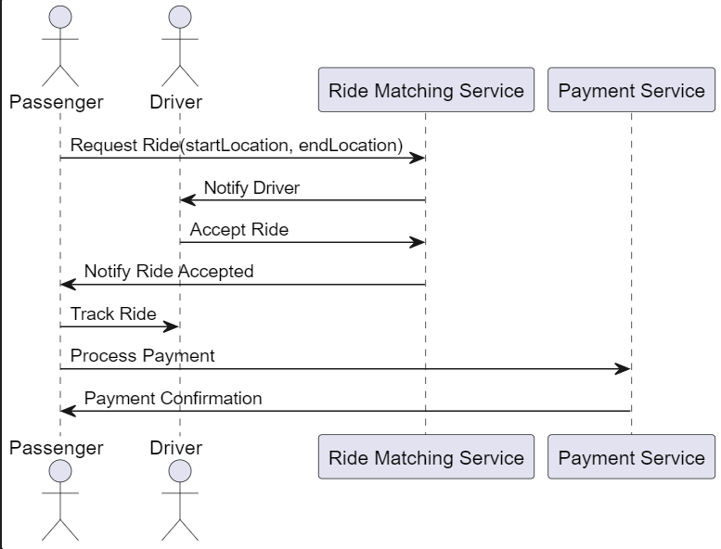
UML SEQUENCE Diagram

Slide 7
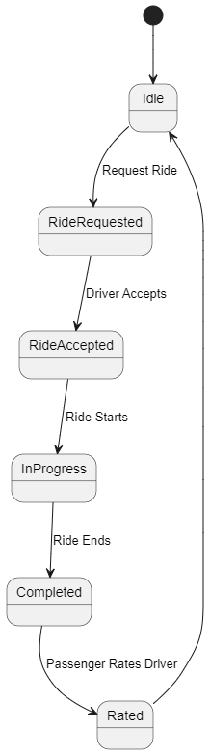
UML State Diagram

Slide 8
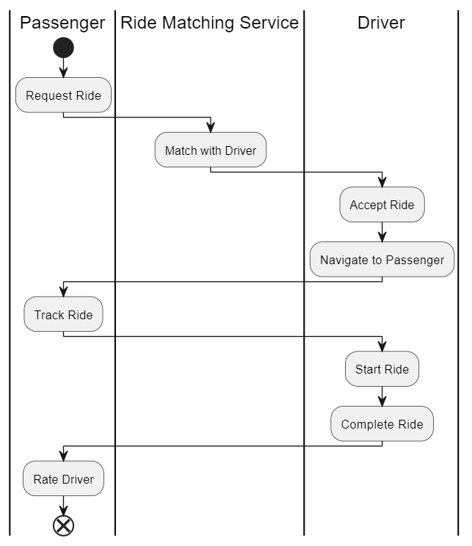
UML ACTIVITY DIARAM

Slide 9
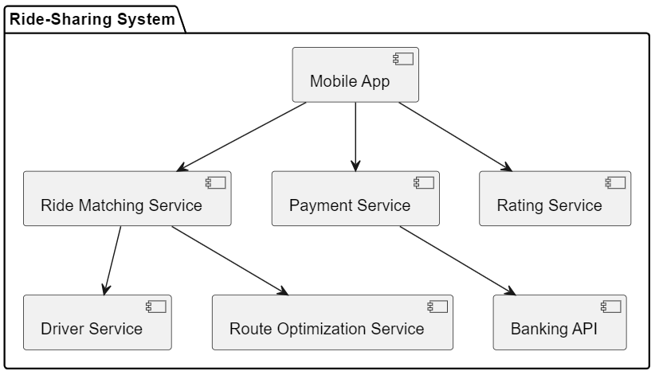
UML COMPONENT DIAGRAM

Slide 10
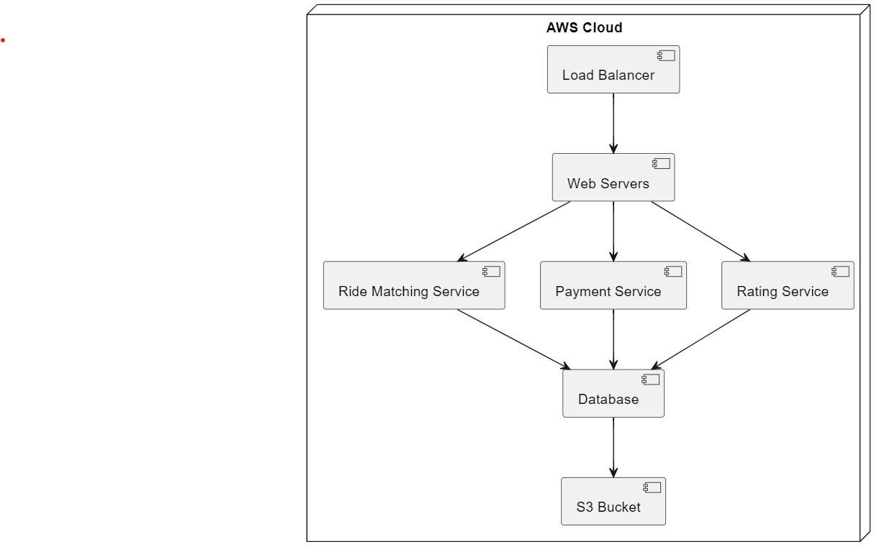
CLOUD DEPLOYMENT DIAGRAM

Slide 11
ARTCHITECTURE PATTERNS
API GETAWAYS
SERVICE SEPARATION USING MICROSERVICES

Slide 12
DESIGN PRINCIPLES AND PATTERNS
Single Responsibility
Interface Segregation
Dependency Inversion
Strategy Pattern

Slide 13
CONCLUSION
Enhanced skills in system design
Provided experience with building systems

